Slide 1
Module 1:
Introduction To System Design
Sanket Singh SWE 2 @ Google

Slide 2
What will you learn
Vertical Scaling
Case study of Stackoverflow
Horizontal Scaling

Slide 3
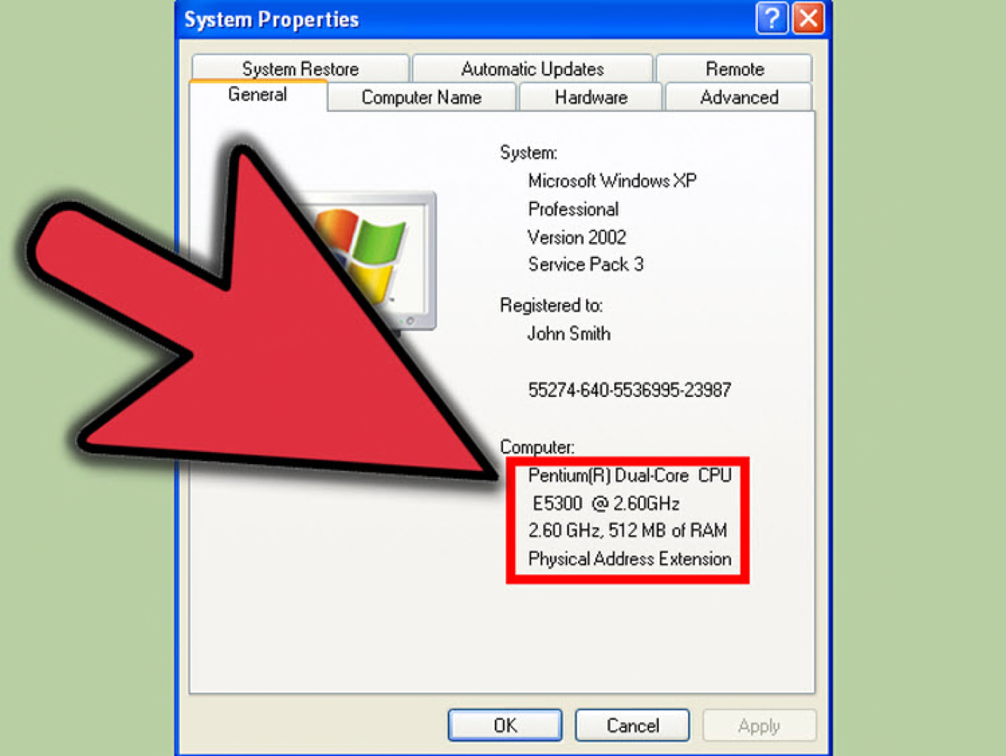
Problems Of LOW machine config
Traffic issues
With every new bookmark storage left was reducing
Notes:
Earlier computers used to come with very low config.

Slide 4
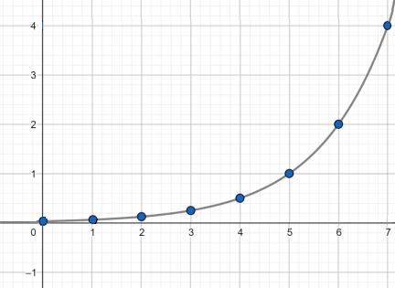
Problems of popularity of the app
Now if we assume that more users will onboard on our app with time. Then a single machine won’t be able to serve all the traffic
The Ram of a single machine won’t be sufficient
Disk storage will also reduce
No. of simultaneous connection won’t be enough
Computation capacity of system will be less.

Slide 5
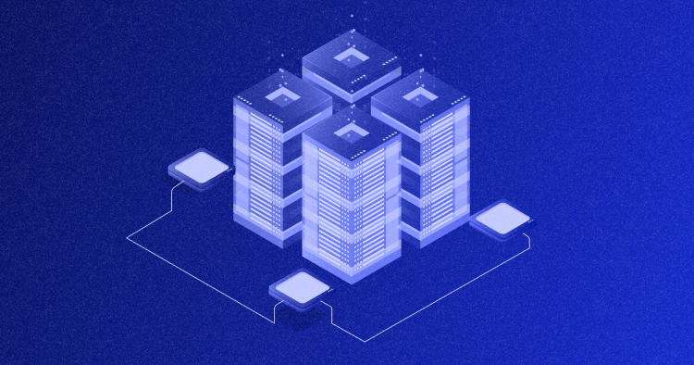
Let’s buy a bigger machine then ?
In earlier days, people used to upgrade to higher machine config.
If let’s say we are out of disk storage them we can buy a machine with a higher disk storage.
We call it as Vertical scaling.

Slide 6

Vertical Scaling

Slide 7
Problems with Vertical Scaling
We cannot always correctly anticipate the amount of traffic we will get later.
Due to this during necessity we upgrade the machine, but it can be a repetitive process and migration to a new heavier machine will be costly.
There is a logical limit to how much more powerful machine we can get.
If we just have a single machine running the server, it can cause single point of failure

Slide 8
Problems with Vertical Scaling
We cannot very easily reduce machine size when there is low traffic.

Slide 9
Key points about Vertical Scaling
It can lead to Single point of failure
We don’t need much network calls here as inter process comm can be sufficient.
Consistency can be easily managed
Can lead to downtime
Less complexity and less management required
Workload can be spread in multiple cores of the machine.

Slide 10

Case study of Stackoverflow
Notes:
http://highscalability.com/blog/2009/8/5/stack-overflow-architecture.html

Slide 11
Stackoverflow used vertical scaling
A significant aspect of Stack Overflow's story is its emphasis on the "scale up" approach, which contrasts with the popular "scale out" method.
Instead of scaling out, Stack Overflow scales up by purchasing more powerful machines and adding more memory when needed. This approach suits their requirements, given their substantial site traffic but not being on the scale of giants like Google. They have various options to scale further, such as caching, adding more web servers, and denormalization.

Slide 12
Stackoverflow used vertical scaling
As per data in around 2011
16 million page views a month
3 million unique visitors a month (Facebook reaches 77 million unique visitors a month)
6 million visits a month
86% of traffic comes from Google
9 million active programmers in the world and 30% have used Stack Overflow.

Slide 13
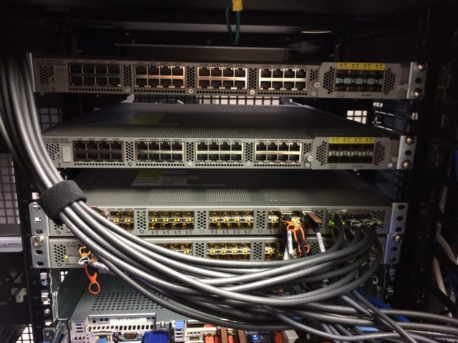
Stackoverflow machine upgrade
Web server
Dell R630
2 x Intel E5-2697 v3 (2.6 GHz, 14-core)
384 GB DDR4 RAM
2 x Intel S3610 1.6 TB SSD (RAID 1)
Notes:
https://blog.serverfault.com/2015/03/05/how-we-upgrade-a-live-data-center/

Slide 14
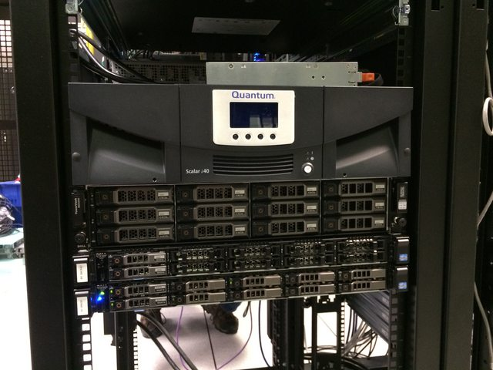
Stackoverflow machine upgrade
DB server
Dell R730xd
2 x Intel E5-2697 v3 (2.6 GHz, 14-core)
768 GB DDR4 RAM
2 x Intel S3610 1.6 TB SSD (RAID 1) for the OS
2 x Intel P3700 1.6 TB NVMe for tempdb
8 x Intel S3610 1.6 TB SSD (RAID 10) for data
2 x Intel S3610 800 GB SSD (RAID 1) for logs
Notes:
https://blog.serverfault.com/2015/03/05/how-we-upgrade-a-live-data-center/

Slide 15
Latest stats for stackoverflow from 2013 to 2016
209,420,973 HTTP requests to the load balancer.
66,294,789 of those were page loads.
1.24 TB of HTTP traffic sent.
569 GB total received.
3.08 TB total sent.
504,816,843 SQL Queries.
5,831,683,114 Redis hits.
17,158,874 Elastic searches.
3,661,134 Tag Engine requests.
607,073,066 ms spent running SQL queries.
Notes:
https://nickcraver.com/blog/2016/02/17/stack-overflow-the-architecture-2016-edition

Slide 16
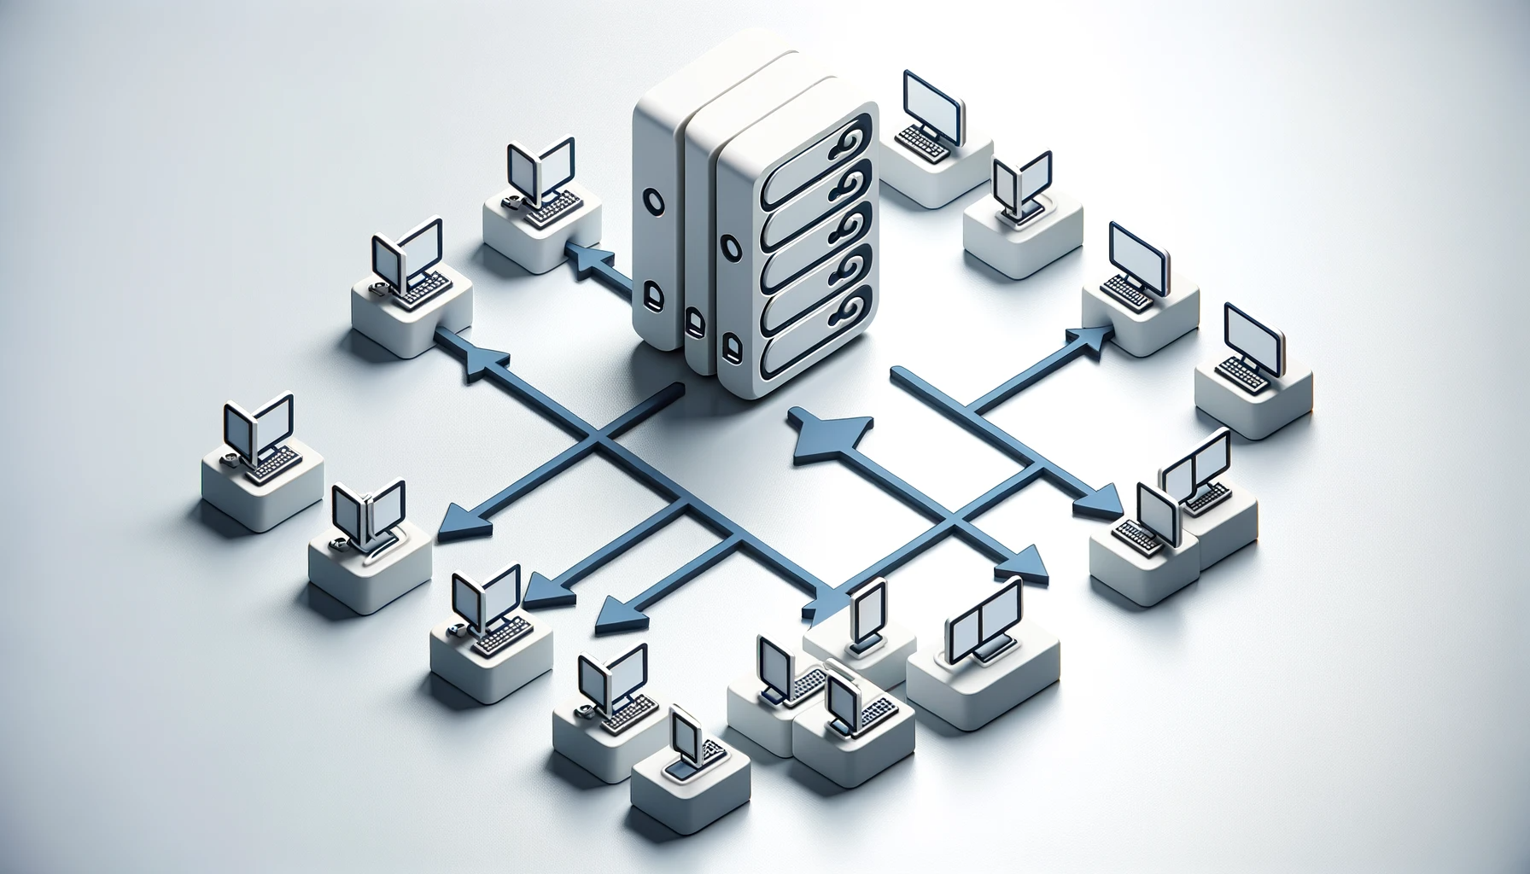
Horizontal scaling

Slide 17
Horizontal Scaling
Rather than investing on getting more powerful machine why now have multiple machine of relatively mediocre power to handle all the load together.
This way multiple normal machines can be deployed to manage them.
Generally if you buy a machine of capacity (in terms of let’s say RAM, storage etc) X, this will be more costly than buying multiple machines with capacity Y, where (Y < X)

Slide 18
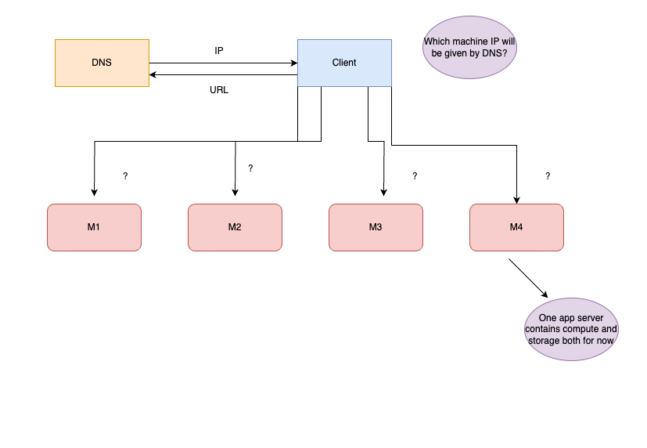
Notes:
Now one question that comes is that if we have multiple app servers running, then which server’s IP will be returned by the DNS ?

Slide 19
DNS should not return IP of app servers..Why ?
As we are using horizontal scaling then we have multiple machine running always
If at some point we have more traffic than regular then we can setup a mechanism using which a new with same config can spawn up and share the load. This is called AUTOSCALING.
We can similarly scale down the no. of active machine in case of low traffic.
Because of the possibility of new machine spawning up and some shutting down we can’t rely on their IP address to be returned by DNS.

Slide 20
How to handle this ?
How about we introduce an intermediate layer between client and app servers ?
We call this layer as LOAD BALANCER…
It can divide requests between diff machines.

Slide 21
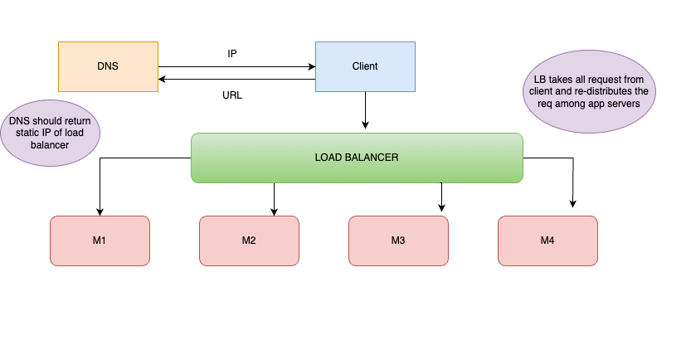

Slide 22
Recap
As the scale on app grows , scalability problem needs to be tackled.
We can improve capability of machine to handle more requests called as vertical scaling
We can deploy multiple machines with mediocre config to balance out the load called as horizontal scaling

